Slide 1
Airline Passenger Satisfaction
The dataset consists of customer satisfaction scores of 120,000+ airline passengers; we random sampled 1000 observations.
Our sample contains information about each passenger as well as details about their flight and flying experience.
Of the 24 columns, we selected five key variables to explore our questions of interest – Departure and Arrival Time Convenience, Satisfaction, Type of Travel, Departure Delay, Arrival Delay.
Goel, Park, Yang, DS 2003, Midterm

Slide 2
Question 1:
How do delays affect passengers’ satisfaction based on their reason for travel?
Notes:
How do delays affect passengers’ satisfaction based on their reason for travel?
Overall satisfaction
Then look specifically at the satisfaction level of departure and arrival time convenience

Slide 3
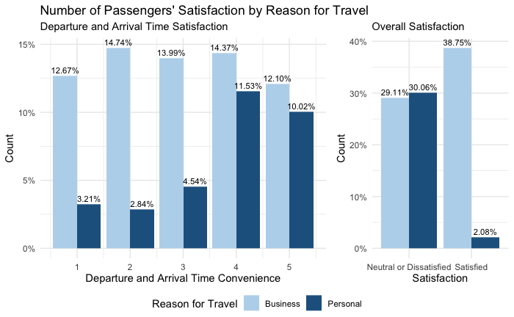
Notes:
The graph consists of two barplots that show the number of passengers’ satisfaction by reason for travel. There are two categories in the reason for travel variable which is “business” (the light blue) and “personal” (the darker blue). The dataset was filtered out for passengers that experienced either a departure or arrival delay which narrowed it down to 554 out the original 1000 observations. The business travellers take up 67.86% of the 554 proportion and personal travellers took up 32.14%. The left barplot shows passengers that rated the flight’s departure and arrival time convenience from 1-5 (5 being very satisfied) and the overall trend shows that delayed passengers flying for business purposes were divided in their satisfaction from a range of 12-15%, but those flying for personal reasons seemed to not mind the delays as much with 4-5 ratings ranging from 10-12% and 1-3 having 2-5%. The right barplot shows a more interesting trend in that business passengers were generally divided in their satisfaction with the overall flight where 57.1% of delayed passengers flying for business reasons were satisfied (including service, comfort, cleanliness, entertainment, etc) while those flying for personal reasons were either neutral or dissatisfied at nearly 93.52% of delayed passengers travelling for personal reasons. An interpretation of why this may be so is that Usually people who do business travel fly often and know what to expect when they're going on planes. Those on personal reasons can be first time or non experienced flyers who have little idea of what flying is like

Slide 4
Question 2:
Is there a relationship between departure delay and arrival delay and what effect does it have on passenger satisfaction?

Slide 5
